Slide 2
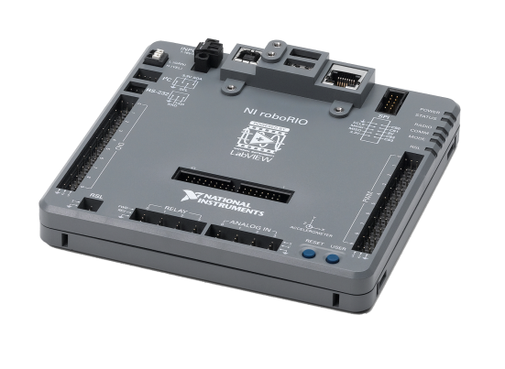


Introducción a roboRIO y LabVIEW FIRST Robotics Competition
Oscar Fonseca
Ingeniería en Aplicaciones
National Instruments de México
Notes:
Hola a todos, bienvenido a este seminario de introduccón a roboRIO y LabVIEW
Yo soy Oscar Fonseca, trabajo en el departamento de ingeniería en aplicaciones de National Instruments y desde hace 6 años he participado en FRC con el equipo Panteras de la Universidad Panamericana Preparatoria.

Slide 3
National Instruments en FRC

Slide 4
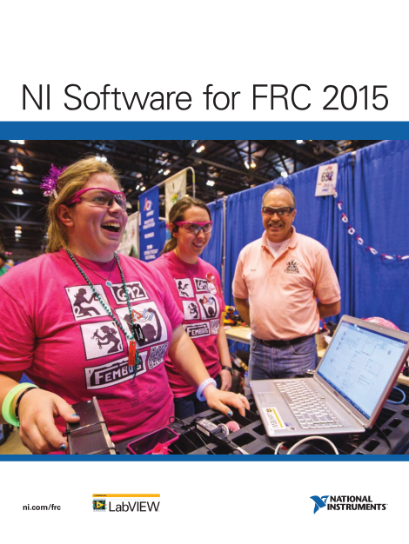
El software de NI para FRC
NI Software for FRC 2016
Incluido en el kit de partes o descargable desde ni.com/frc
LabVIEW 2015
LabVIEW 2015 Real-Time
Vision Development Module
IMAQdx 14.0 (vision driver)
NI-RIO (roboRIO driver)
FRC 2016 Simulation
FRC 2016 Update Suite
TODOS los equipos FRC deben descargarlo
Driver Station
roboRIO Utilities
WPI Library
FRC LabVIEW Templates
FRC LabVIEW Examples
Todos los links de descarga se encuentran en ni.com/frc
Notes:
All teams should get an “NI Software for FRC 2015” cardboard envelope in their kit of parts containing the NI Software DVD. You can use the DVD to install the standard NI software. Be sure to save this envelope in case you need to reinstall or reactivate later.
If you don’t have a DVD drive or you want the NI software before you get your kit of parts, you can also download it at ni.com/frc. It is a 4.6 GB download, so it may take a while depending on your Internet connection. Even if you download the software, you still need the serial number from the DVD envelope to activate it.
Regardless of what software your team plans to use (C++, Java, LV) you need to download the FRC 2015 Update Suite. It includes the driver station, dashboard, roboRIO imaging tool as well as all of the FRC specific content like the FRC Examples and Templates. (~900MB)

Slide 5
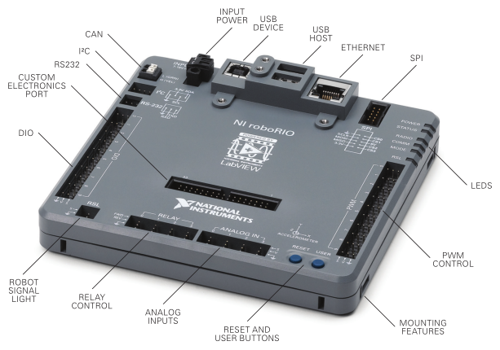
El hardware para FRC
El roboRIO

Slide 6
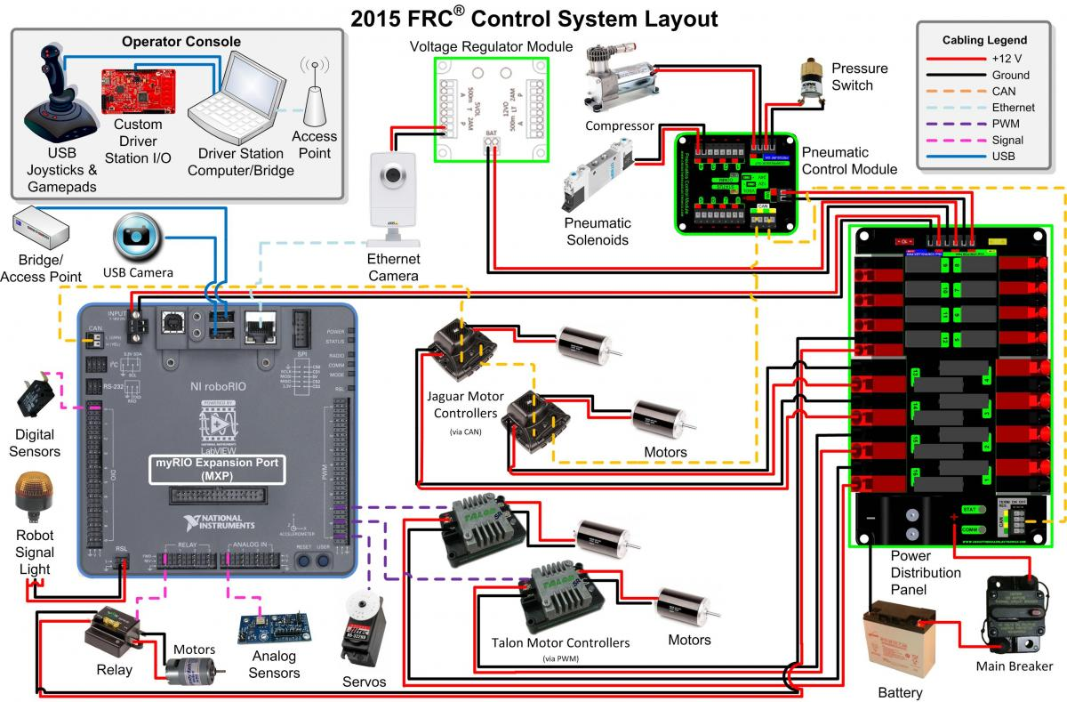
El hardware para FRC

Slide 7
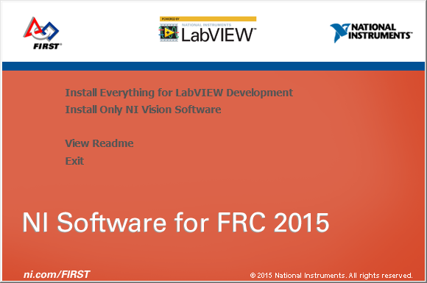
Instalación del software para FRC
1. Ejecutando el instalador
NI Software for FRC 2016 (en DVD o descargado)
Si descarga el software, debe primero extraer y ejecutar el AutoRun.exe
Si programa en LabVIEW
Si programa en C++/Java pero quiere usar NI vision
Notes:
Use the DVD from your kit of parts or download the “NI Software for FRC 2015” file from ni.com/frc. Once you download the software click on Autorun.exe
[Note to instructor: Be sure to explain that they need to download, unzip, and then install the software. We’ve gotten a lot of questions about this.]
Click next on the first screen and then select the products you would like to install.
[Animation]
If you plan to develop your robot in LabVIEW, install all of the components.
If you are using C++ or Java but still want to use the NI Vision Development Module, just install it and deselect all of the other components.

Slide 8
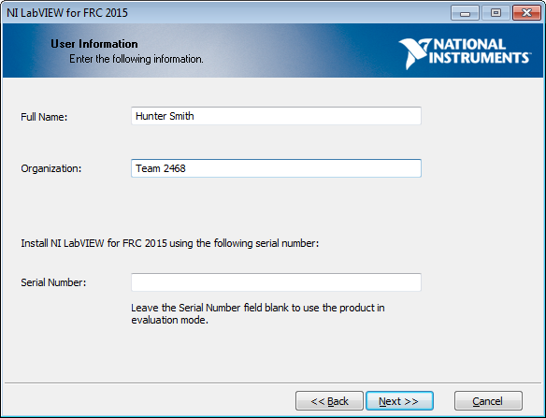
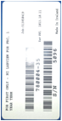
Instalación del software para FRC
2. Activando su licencia
Active LabVIEW utilizando el número de licencia que se encuentra atrás de su sobre con el DVD.
Número de serie
Notes:
During the installation process, you will be prompted for the serial number on the back of the DVD envelope. Be sure to enter your team number for the organization.
If you don’t have your kit of parts yet, you can leave the serial number blank to install as a trial until you get your serial number.
Later in the installation process, you will be prompted to activate Vision. Use the same serial number.

Slide 9
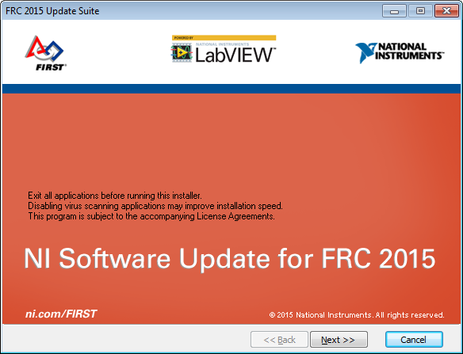
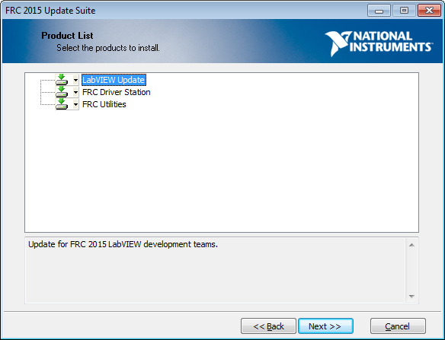
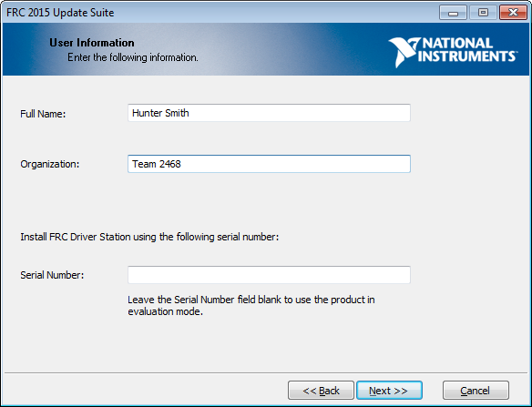
Instalación del software para FRC
3. Instalación de la suite de actualización
Todos los equipos deben instalar la suite de actualización FRC
Instale la actualización después de LabVIEW
Instale los componentes
LabVIEW Teams : Todo
Java/C Teams: Driver Station & Utilidades
Actívelo con el mismo número de serie que viene en su sobre de NI LabVIEW
Notes:
The FRC 2015 Update Suite contains all of the FRC-specific software made by NI.
[Animation]
All teams need to install the FRC utilities to image the roboRIO controller and install the FRC Driver Station to control their robots.
If you are using LabVIEW, you need the LabVIEW Updates to install the FRC specific content and FRC project templates.
[Animation]
The FRC Update Suite include vision components that need to be activated, so use the same serial number from your FRC DVD envelope

Slide 10
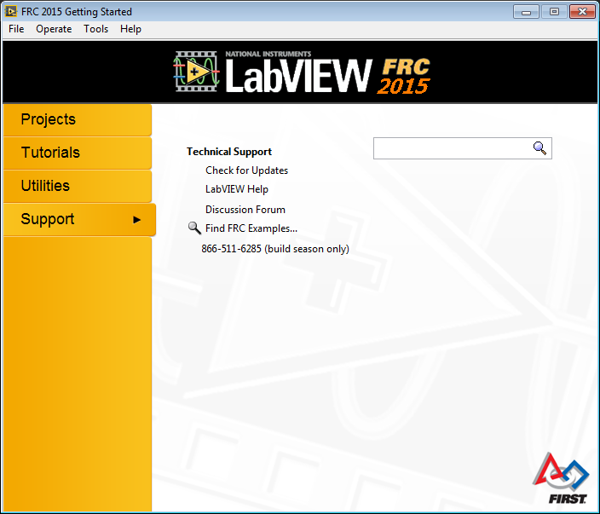
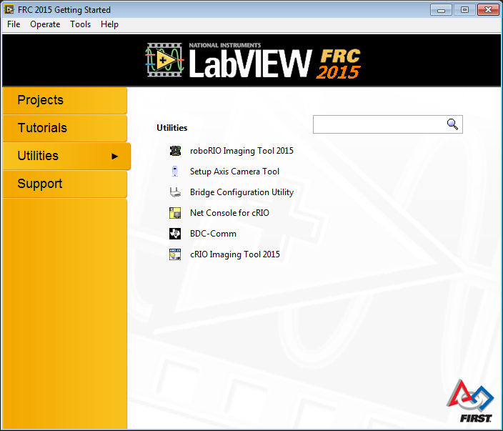
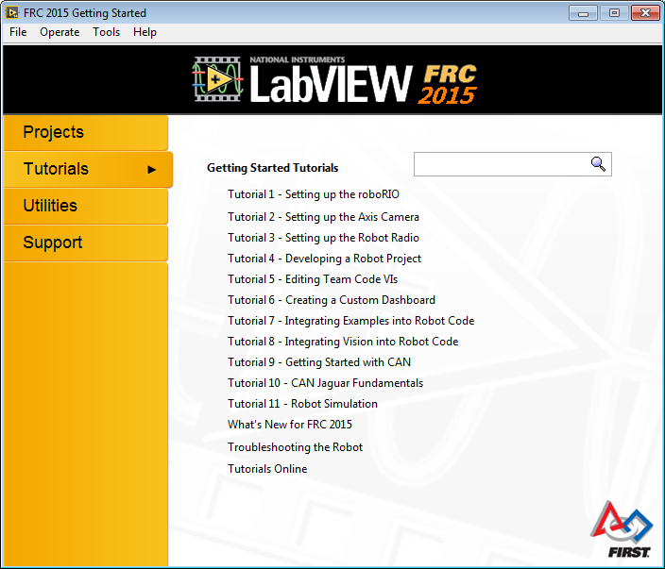
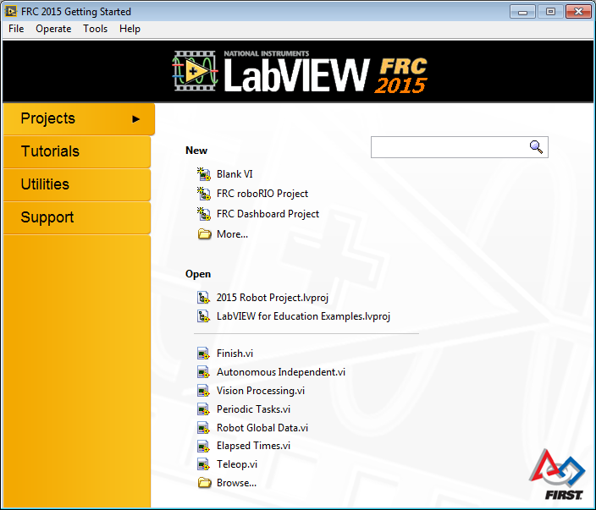
El software de NI para FRC
La ventana de inicio
Ésta ventana se abrirá siempre que se inicie FRC LabVIEW.
Entrenamiento
Herramientas
Crear Nuevo proyecto
Ayuda
Proyectos recientes
Call for Help
Notes:
After you install LabVIEW and the Update Suite and when you start LabVIEW, you will see the FRC Getting Started window.
This window is packed with useful information and tools.
Note: You can open the Getting Started window by closing all VIs and projects OR you can go to View»Getting Started Window from any LabVIEW window.
Project: When you are ready to start programming, just create a new FRC cRIO Robot Project to get a project with everything set up and ready to go.
[Animation]
Tutorials: Start with the tutorials to explore in detail different aspects of LabVIEW and the roboRIO controller.
[Animation]
Utilities: This section offers quick links to all of the tools and utilities you need for FRC.
[Animation]
Support: If you ever get stuck, use the link to the forums as well as the phone support number to get help from an engineer during the build season.

Slide 11
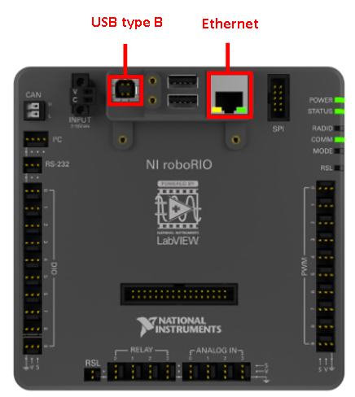
Getting Started
Cargar la imagen al roboRIO
1. Conectar el roboRIO a la computadora
USB: 172.22.11.2
Ethernet: DHCP
Notes:
We recommend imaging the roboRIO while it is connected directly to a computer using the USB-B port on roboRIO. This ensures the most reliable connection and bypasses most firewall and network restrictions.
However, you can connect the roboRIO to the Ethernet port of your computer directly using an Ethernet cable or indirectly through the D-Link bridge. Just be aware that firewall and network settings on the computer may block Ethernet communication with the roboRIO. We do not recommend imaging the roboRIO over a wireless connection with the D-Link bridge because the roboRIO may lose connectivity during the imaging process and enter an unknown state.

Slide 12
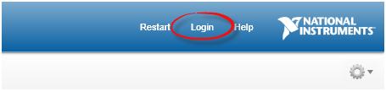
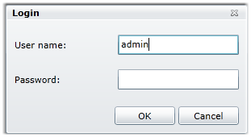
Getting Started
Cargar la imagen al roboRIO
2. Ingresar a la interfaz web del roboRIO
Usar el navegador de internet para entrar a la IP del roboRIO
Notes:
Updating the firmware on the roboRIO first requires that you navigate to the Web Interface. This can be done by typing the IP address of your roboRIO into a browser window. The roboRIO’s IP address can be determined using the methods described in the section titled “Communicating with your roboRIO.”
Once the Web Interface loads, you must login to give yourself administrative privileges. Click “login” to open a new dialog window which prompts for your username and password.
USAMOS HYYP://IP-DEL-ROBORIO

Slide 13
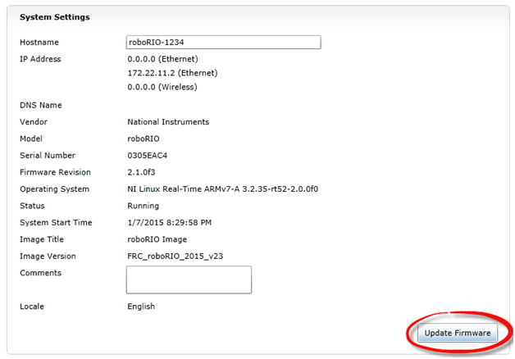
Getting Started
Cargar la imagen al roboRIO
3. Actualizar el frimware del roboRIO (si es necesario)

Slide 14
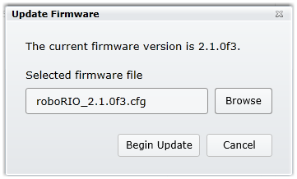
Getting Started
Cargar la imagen al roboRIO
3. Actualizar el frimware del roboRIO (si es necesario)
El archivo se encuentra en C:\Program Files (x86)\National Instruments\Shared\Firmware\cRIO\76F2

Slide 15
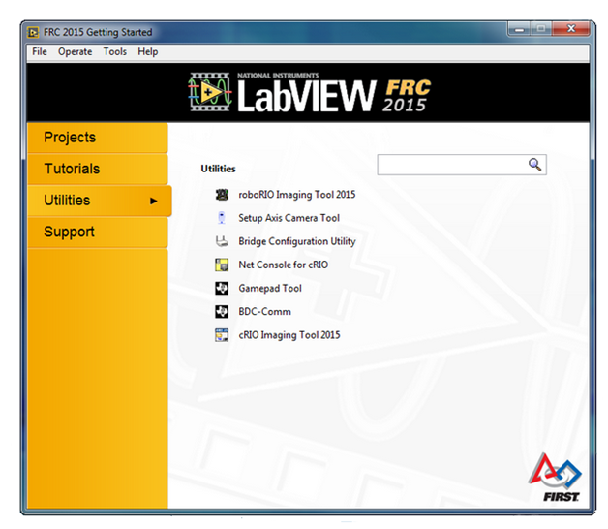
Getting Started
Cargar la imagen al roboRIO
4. Abrir el roboRIO Imaging Tool
Notes:
The roboRIO Imaging Tool is used to deploy an FRC roboRIO Image to the roboRIO. You can find the roboRIO Imaging Tool by selecting utilities from the LabVIEW getting started window. Click roboRIO Imaging Tool 2015 from the list of utilities to open it. If you have not installed the LabVIEW development environment, you can find the roboRIO imaging tool on your computer using Windows explorer and running “roboRIO_ImagingTool.exe” found in this default directory::
C:\Program Files (x86)\National Instruments\LabVIEW 2014\project\roboRIO Tool

Slide 16
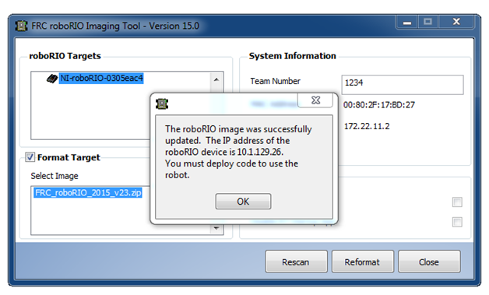
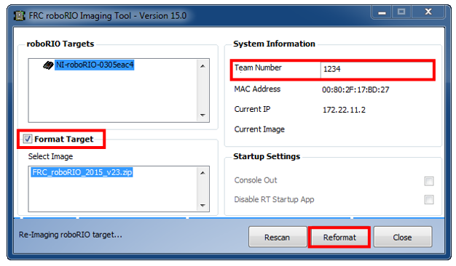
Getting Started
Cargar la imagen al roboRIO
5. Configurar la imagen a instalar
Notes:
The imaging tool will automatically search for and detect roboRIO targets connected to the computer over USB or Ethernet. Once detected by the imaging tool, your roboRIO will appear under the list of discovered targets. If your roboRIO is not automatically detected see the troubleshooting steps in the Troubleshooting Techniques section.
Make sure your roboRIO is selected amongst the list of discovered targets. Then enter your team number into the appropriate field. Check the box next to “Format Target” and click the ”Reformat” button. The message “Re-Imaging roboRIO target…” will remain displayed in the bottom left of the window for the duration of the imaging process.

Slide 17
Configurando el radio

Slide 18
Getting Started
Configurando el Radio del robot
Antes de empezar:
Desactive las conexiones WiFi en su computadora
No conecte dispositivos adicionales al bridge inalámbrico.
La utilidad de configuración del radio FRC usa Java Runtime Engine
Requiere de privilegios de administrador
Si causa problemas, puede ser por el idioma de Windows
Notes:
The 2016 FRC Radio Configuration Utility requires the Java Runtime Engine (JRE). If you do not have Java installed, you can download the JRE from here: https://www.java.com/en/download/
The FRC Radio Configuration Utility requires Administrator privileges to configure the network settings on your machine. The program should request the necessary privileges automatically (may require a password if run from a non-Administrator account), but if you are having trouble try running it from an Administrator account.
Application Notes
The 2016 Radio Kiosk will program the radio to enforce the 7Mbps bandwidth limit on traffic exiting the radio over the wireless interface. In the home configuration (AP mode) this is a total, not a per client limit. This means that streaming video to multiple clients is not recommended.
The 2016 Kiosk has been tested on Windows 7, 8 and 10. It may work on other operating systems, but has not been tested.

Slide 19
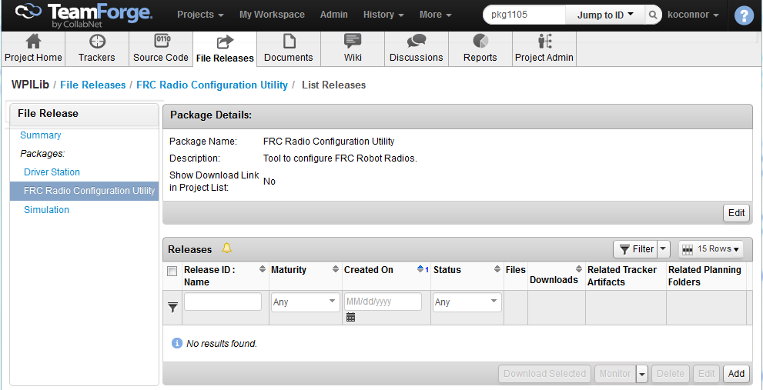
Getting Started
Configurando el Radio del robot
1. Descargue el software más reciente de configuración desde el sitio de WPILib project File Releases.
Notes:
Download the latest FRC Radio Configuration Utility Installer from the WPILib project File Releases: https://usfirst.collab.net/sf/frs/do/listReleases/projects.wpilib/frs.frc_radio_configuration_utility

Slide 20
Getting Started
Configurando el Radio del robot
2. Instale la utilidad: De doble click en el archivo descargado FRC_Radio_Configuration_MM_DD_YY.exe para abrir el instalador.
Siga las instrucciones en pantalla para completar la instalación.
Notes:
Double click on FRC_Radio_Configuration_MM_DD_YY.exe to launch the installer. Follow the prompts to complete the installation.

Slide 21
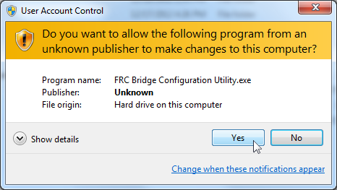
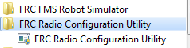
Getting Started
Configurando el Radio del robot
3. Ejecute el software: Vaya al menú de inicio y ejecute la utilidad de configuración. Conceda los permisos de administrador si se requiere.
Notes:
Use the Start menu or desktop shortcut to launch the program.
Note: If you need to locate the program it is installed to C:\Program Files (x86)\FRC Radio Configuration Utility. For 32-bit machines the path is C:\Program Files\FRC Radio Configuration Utility\
If the your computer is running Windows Vista or Windows 7, a prompt may appear about allowing the configuration utility to make changes to the computer. Click "Yes" if the prompt appears.

Slide 22
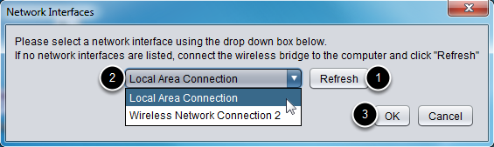
Getting Started
Configurando el Radio del robot
4. Seleccione la conexión de red: Seleccione Refresh para escanear las interfaces posibles, posteriormente elija el puerto Ethernet “Local Area Connection”. De click en “Ok”.
Notes:
Use the pop-up window to select the which ethernet interface the configuration utility will use to communicate with the wireless bridge. On Windows machines, ethernet interfaces are typically named "Local Area Connection". The configuration utility can not program a bridge over a wireless connection.
1. If no ethernet interfaces are listed, click "Refresh" to re-scan for available interfaces
2. Select the interface you want to use from the drop-down list
3. Click "OK"

Slide 23
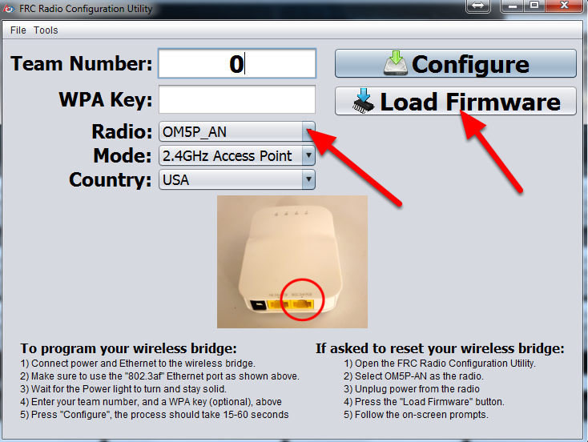
Getting Started
Configurando el Radio del robot
Nota: Todos los radios incluidos en el kit de partes 2016 ya cuentan con el Frimware necesario. En caso de necesitar resetearlo siga las instrucciones que vienen en el software.
Notes:
OM5P-AN Firmware Note
For the FRC Radio Configuration Utility to program the OM5P-AN radio, the radio must be running an FRC specific build of the OpenWRT firmware. Radios recieved in the KOP are already flashed with the FRC firmware and should not need to be re-flashed, proceed to the next step.
If you do need to re-flash the firmware, or reset the radio (the only way to reset is to re-flash), see the instructions at the end of this document on how to do so using the FRC Radio Configuration Utility.

Slide 24
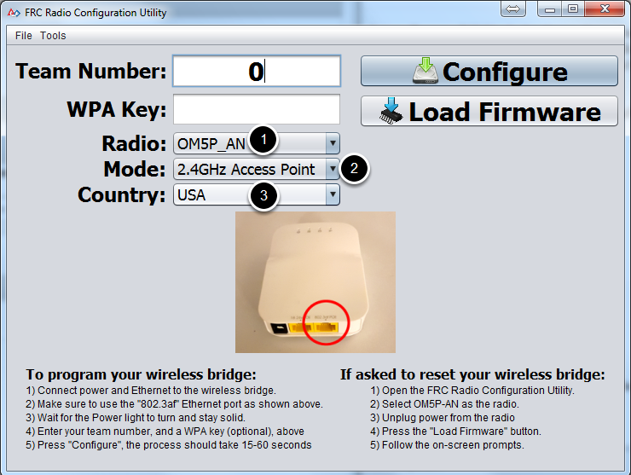
Getting Started
Configurando el Radio del robot
5. Seleccione el modelo y modo de operación
Notes:
Select which radio you are configuring using the drop-down list.
Select which operating mode you want to configure. For most cases, the default selection of 2.4GHz Access Point will be sufficient. Note that the 2.4GHz + 5GHz simultaneous AP mode is not supported by the D-Link radios.
If located outside the USA, select the Country as well to program the proper country specific restrictions

Slide 25
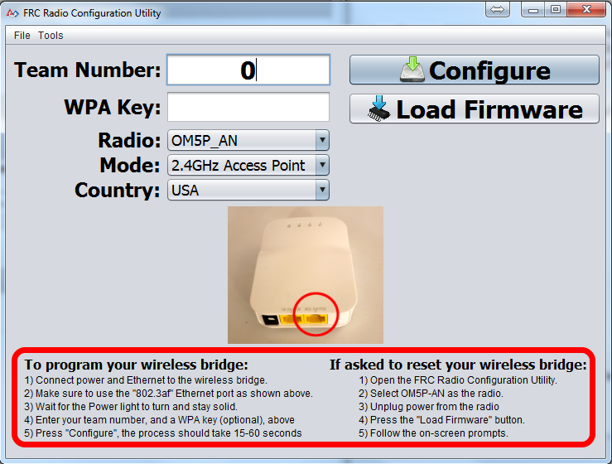
Getting Started
Configurando el Radio del robot
6. Prepare y realice el proceso de configuración
Notes:
Follow the on-screen instructions for preparing your wireless bridge, entering the settings the bridge will be configured with, and starting the configuration process. These on-screen instructions update to match the bridge model and operating mode chosen.

Slide 26
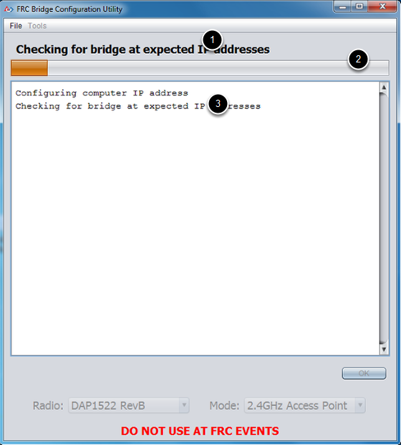
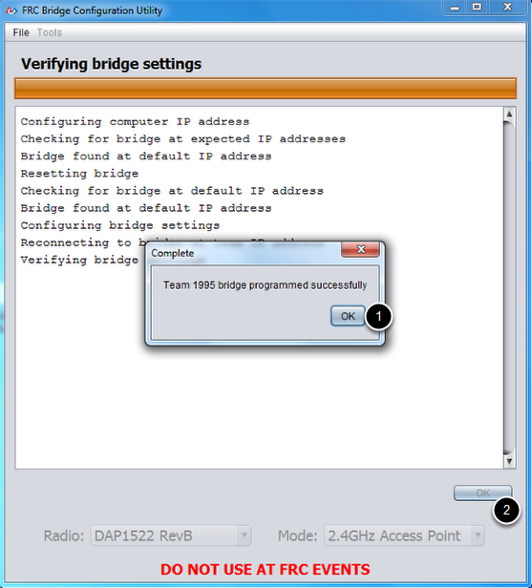
Getting Started
Configurando el Radio del robot
7. Proceso de configuración
Notes:
Throughout the configuration process, the window will indicate:
The step currently being executed
The overall progress of the configuration process
All steps executed so far
Once the configuration is complete:
Press "OK" on the dialog window
Press "OK" on the main window to return to the settings screen
If an error occurs during the configuration process, follow the instructions in the error message to correct the problem.

Slide 27
Un vistazo al software de NI para FRC

Slide 28
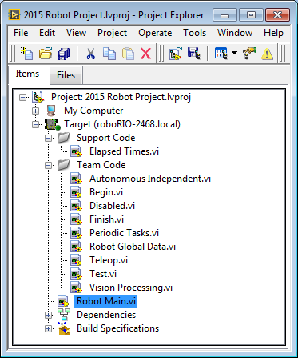
Usando el Software
El proyecto de roboRIO
En el navegador de proyectos de LabVIEW se puede ver todo el código que se ejecutará en el robot. El software de FRC incluye una plantilla con todo lo que necesitas para empezar.
Todo el código que necesita cambiar está en el folder de “Team Code”
El Robot Main se comunica con el Sistema de control de la cancha y ejecuta el código de tu equipo (no lo edites)
Notes:
Use the LabVIEW project to organize many LabVIEW programs or virtual instruments (VIs) in one place. When you create a new roboRIO Robot Project, it includes all of the VIs you need.
Robot Main is the program that communicates with the field control system and runs all of your team code. You should not need to edit this.
The VIs your team needs to edit are included in the Team Code folder. Each VI features instructions and example code to help you get started.

Slide 29
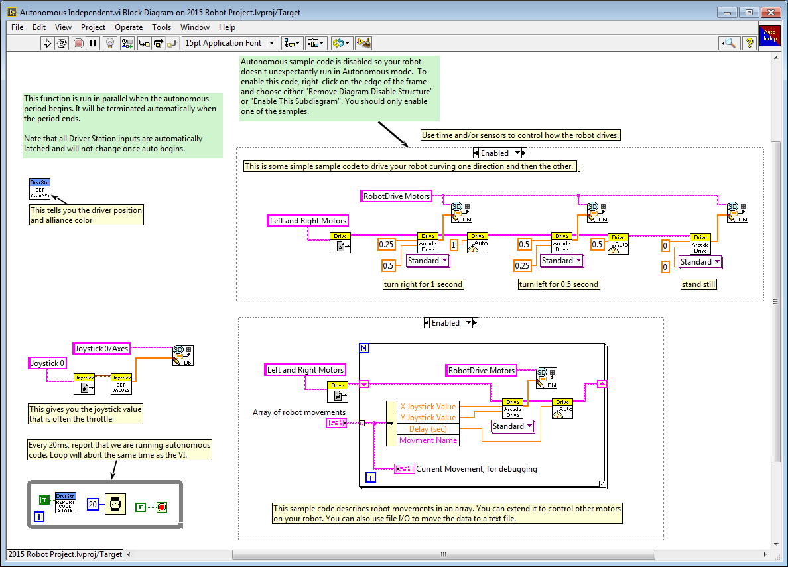
Usando el Software
El código del equipo
Éste es el Autonomous Independent VI para crear tu programa autónomo. Es uno de los VIs que debes editar.
Instrucciones incluidas
Edita este código
Edita este código
Notes:
The Autonomous Independent.vi is one of the VIs in the Team Code folder. The default code shows you how to access all of the inputs and sensors you need to make a smart autonomous program. Be sure to read through all of the instructions so you know what everything does.

Slide 30
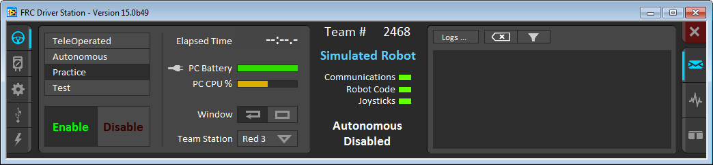
Usando el Software
La Driver Station
La Driver Station es la utilidad de control del robot para práctica y competencia de todos los equipos FRC. Ábrela para conectarte a tu robot y ejecutar el código que escribas.
Operation Tab
Información del robot
Modo de mensajes
Modo
Todas las luces deben estar prendidas en verde
Notes:
The Driver Station is an executable utility that all FRC teams are required to use on their driver station PCs. Once you have written your code, you can connect to the roboRIO controller and deploy and run your code from here.
The right side and left side of the dashboard allow you to select different tabs independent and the middle Robot Info section is always visible.
Operation tab: This tells you which stage of the game you’re in, and info about your Dashboard PC. From here, you can enable your robot, test your code, and set up for competitions.

Slide 31
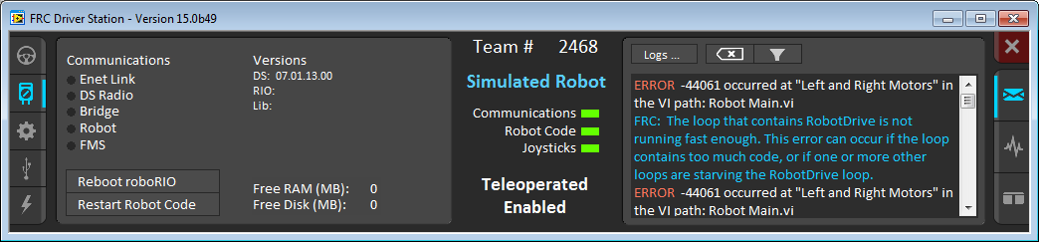
Usando el Software
La Driver Station
Diagnostics Tab
Mensajes de error
Reinicia fácilmente desde el Dashboard
Notes:
The Driver Station is an executable utility that all FRC teams are required to use on their driver station PCs. Once you have written your code, you can connect to the roboRIO controller and deploy and run your code from here.
Diagnostics tab: This includes communication info versions and includes buttons to easily reboot your roboRIO or relstart the code.
This page also shows and error message on the Messages section

Slide 32
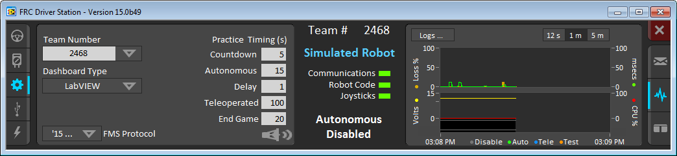
Usando el Software
La Driver Station
Set Up Tab
Configura los ajustes del partido
Chart Mode
Notes:
On the left we see the setup tab- This is where you configure your team info, set practice round timing, and choose your dashboard type.
On the Right the Chart mode where the dashboard shows info about the battery state, communication, and CPU information.

Slide 33
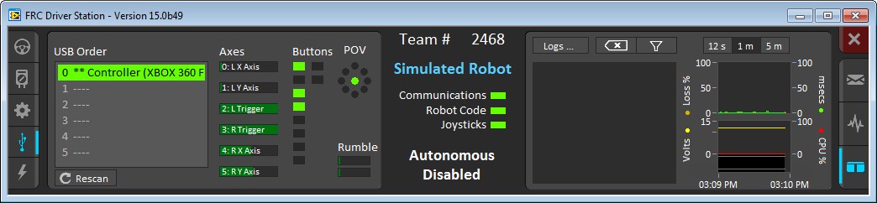
Usando el Software
La Driver Station
USB Devices Tab
Entradas del joystick en vivo
Modo de mensajes y gráficas
Notes:
On the Left we have the USB devices Tab which shows controllers other USB devices connected to your dashboard computer, and displays live inputs from your joystick(s)
On the right we are showing the messages and chart mode where both sets of diagnostic info are visible at once.

Slide 34
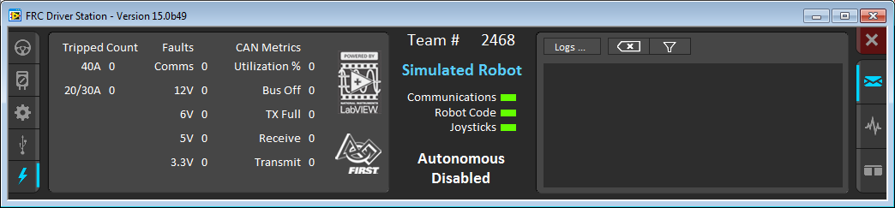
Usando el Software
La Driver Station
Power & CAN Tab
Notes:
And finally on the Power & CAN tab we can find basic info about the CAN connections and Power Distribution board if the PD board is connected over CAN.

Slide 35
Moviendo un robot
Paso 1: Abrir una plantilla de proyecto
Desde la ventana principal de LabVIEW seleccionar New»FRC roboRIO Robot Project para crear un proyecto.
Notes:
In the next few slides, learn how to start driving in 5 steps. If you have LabVIEW and the FRC 2015 Utility Package installed, you can follow along. You can complete this tutorial with real hardware or with a simulated robot. You need a joystick to drive, so make sure yours is plugged in.
Open LabVIEW and start by creating a new roboRIO Robot Project.

Slide 36
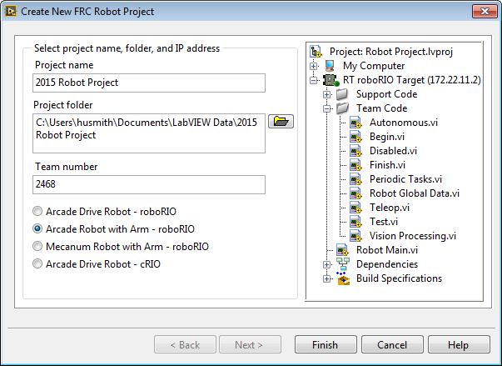
Moviendo un robot
Paso 2: Configurar el proyecto de roboRIO
Llene los datos del nuevo proyecto. Dele un nombre, configure su número de equipo y escoja el tipo de proyecto.
Selecciona el Proyecto acorde a tu tren motriz y accesorios
Notes:
After you create a new roboRIO Robot Project, you see this dialog.
Give your project a good name, specify where you want to save everything, set your Team Number which will be used to automatically generate an IP address, and select the drive style that most resembles your robot.

Slide 37
Moviendo un robot
Paso 3: Abra la plantilla del proyecto
Abra el Robot Main.vi dando doble click en la ventana del proyecto. El panel frontal se debe iniciar. De <Ctrl+E> para ver el diagrama de bloques.
Si añades nuevos Vis, asegúrate de que estén en el dispositivol
El código que debes editar está en el folder de “Team Code”
Para manejar tu robot, abre Robot Main.vi
Notes:
The default project that is generated is already drivable as soon as you open it. The default code is simple and just has the drive modes implemented. By default, the autonomous code does nothing until you go in and edit it. Robot Main is the master program that deploys and runs all of the team code. For this exercise, you want to run just the default code, so open Robot Main by double-clicking on it.

Slide 38
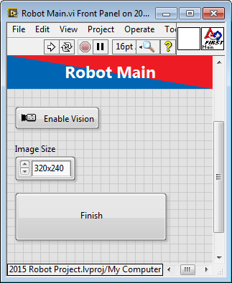
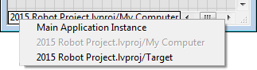
Moviendo un robot
Paso 4: Seleccionando el dispositivo
Si tiene un roboRIO conectado, asegúrese de seleccionarlo. Si no tiene uno, puede simularlo. Seleccione …lvproj/My Computer para abrir el simulador.
roboRIO simulado
roboRIO real
Notes:
In the bottom left corner of both the front panel (grey) window and the block diagram (white), the target for execution is listed. To change the target, right-click on the white box and select your target. When you right-click, you’re changing the deployment environment. It may take a few minutes to load the simulation VIs.
Only a joystick is needed to simulate a robot.

Slide 39
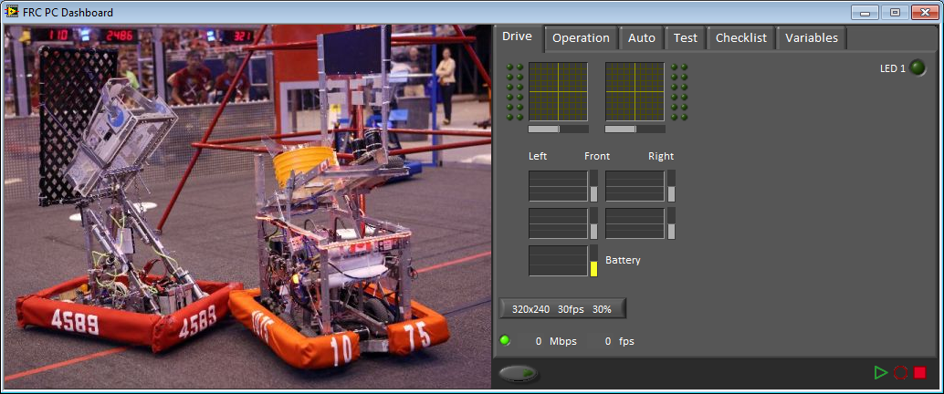
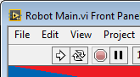
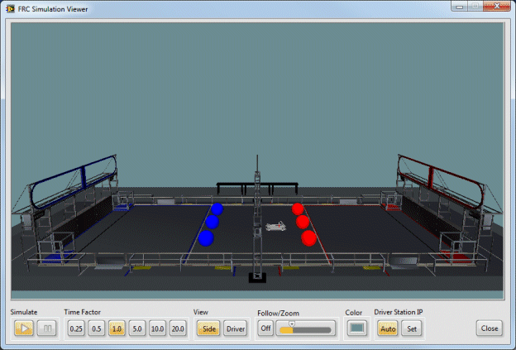
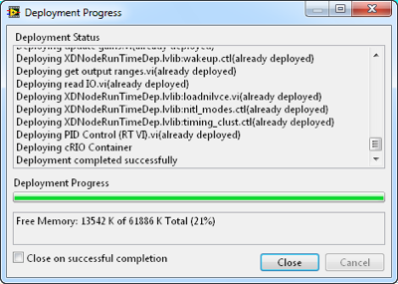
Moviendo un robot
Paso 5: Descargar el código
De click en la flecha blanca en la parte superior izquierda del Robot Main. El proyecto se descarga al roboRIO/simulador, cuando termine se abrirá la Driver Station. Los LEDs deben estar todos en verde. Seleccione TeleOp y Start.
Notes:
You can press the Run button from either the block diagram or front panel. LabVIEW must be able to establish a connection to the roboRIO controller to deploy to it.
If you are using a real robot, check the three lights in the Driver Station to make sure the joystick, robot code, and communication are all good before enabling TeleOp.
Once TeleOp is enabled, the robot is live!
Note: Since you ran the code instead of deploying it, the roboRIO controller runs the code only until it’s reset or power cycled. It does not start up automatically unless the application is built and set to run at startup.

Slide 40
Primeros pasos en LabVIEW
Aprendiendo a usar el software

Slide 41
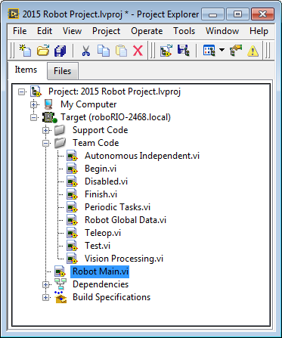
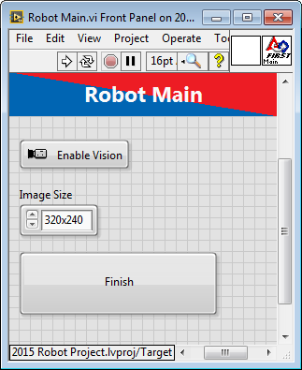
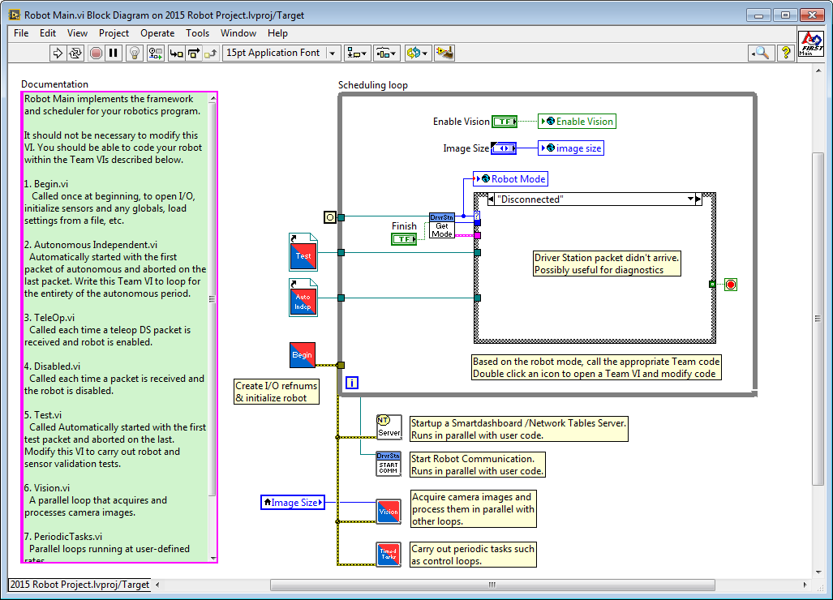
Conociendo LabVIEW
Partes del Robot Main.vi
Diagrama de bloques
(código)
Panel frontal
(interfaz de usuario)
Explorador de proyectos de LabVIEW
Notes:
During the next exercise, when you configure a new project in LabVIEW FRC, you can use a default code template. By using this template, you can drive the robot in Arcade mode without making any code changes.
In the coming slides, investigate the block diagram (code) of the Robot Main.vi to understand the key components and their functions.
The front panel is the user interface for the program where you place controls to input values to the system and indicators to display outputs to the user.
The block diagram contains the graphical source code.
Icon: Graphical representation of a VI
Connector Pane: Map of the inputs and outputs of a VI
You need the icon/connector panes to use a VI as a subVI. The connector pane is a map of the inputs and outputs of a VI.
A subVI is similar to a subroutine or function in a text-based programming language.

Slide 42

Conociendo LabVIEW
El explorador de proyectos
LabVIEW File Extensions
LabVIEW project—.lvproj
Virtual instrument (VI)—.vi
Custom control—.ctl
Ubicación de los archivos en Windows
Clck derecho para conectarse al dispositivo roboRIO
Notes:
You can use the LabVIEW project to access and organize project files. You view project files in the Project Explorer window. Project files can include LabVIEW and non-LabVIEW files.
You can use LabVIEW to build an executable and installer. Various hardware courses use the LabVIEW Project Explorer to configure and deploy applications to a target.

Slide 43
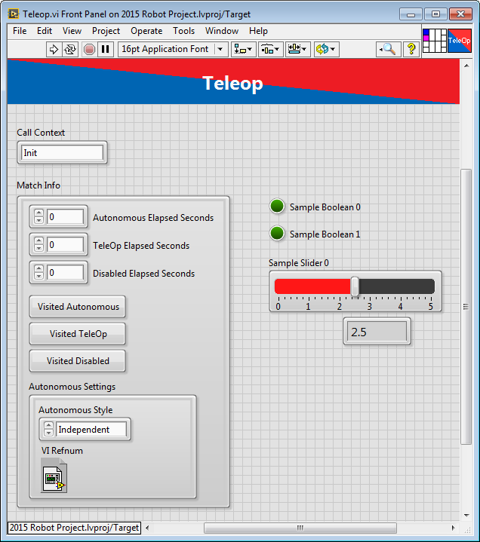
Conociendo LabVIEW
Partes de un VI: El panel frontal
El panel frontal es la interfaz gráfica de entradas y salidas.
Control numérico
Indicador LED
Control de deslizador
Control booleano (on/off)
Notes:
Discuss how a front panel is the user interface of the VI and contains controls and indicators. A section following this slide concentrates on the front panel in more depth.

Slide 44
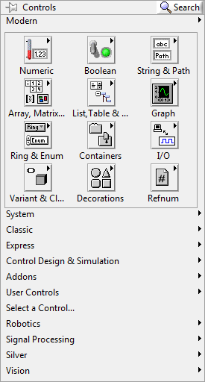


Conociendo LabVIEW
La paleta de controles
Buscar controles
Click derecho en el panel frontal (no en el diagrama de bloques) para abrir la paleta de controles
Fijar para mantener abierto
Abrir subpaletas
Notes:
With the Controls Palette, you can access all of the controls and indicators that are placed on the front panel. Right-click on the FRONT PANEL (not the block diagram) to browse the Controls Palette.
Use the thumbtack in the top left corner to lock the front panel so it stays open.
The modern, silver, classic, and system palettes all have a different look and feel, but they all function the same.
You can even create custom controls and indicators using your own graphics. There is a link to a tutorial in the references section.

Slide 45

Conociendo LabVIEW
El diagrama de bloques
El diagrama de bloques es el código de cada VI. En LabVIEW, los bloques gráficos son conectados con cables para controlar la ejecución.
Ciclo
Terminal
(objetos del panel frontal)
Función
Notes:
The block diagram is the graphical code that controls how the program executes. Block diagrams are composed of functions, terminals, and constants connected by wires. Like any programming language, LabVIEW has loops, Case structures, and conditional statements, but in LabVIEW, it’s all graphical.

Slide 46

Conociendo LabVIEW
La paleta de funciones
Buscar funciones por nombre
Click derecho en el diagrama de bloques (no el panel frontal) para abrir la paleta de funciones
Contiene a los VIs, funciones y constants que se pueden usar en el diagrama de bloques
Las paletas específicas para FRC incluyen la librería de robótica de WPI, FIRST Vision y PID
Notes:
Open the Functions Palette by right-clicking on the BLOCK DIAGRAM (not the front panel). You can browse through hundreds of functions sorted by type or search directly for a function by name using the search button in the top right corner. When you install the FRC 2015 Update Package, you see a few extra palettes specific to FIRST.
The FIRST WPI Robotics Library, Vision, and PID palettes all include functions you need to program your robot.

Slide 47



Conociendo LabVIEW
Las terminales
Con las terminales se puede leer y escribir a controles e indicadores del panel frontal.
Mismo nombre
Notes:
Data values you enter on the front panel controls enter the block diagram through the control terminals on the block diagram.
During execution, the output data values from the block diagram pass from indicator terminals to the front panel indicators.
Front panel items share the same label name as the block diagram terminal. When you change one, both change.
Note the visual difference between controls and indicators on the block diagram. The little arrow on the terminal shows where the wires connect. Controls output the value on the right side and indicators read the value from the left side.
Note that constants (the Triangular Multiplier) are available only on the block diagram.
You can right-click a terminal to change it between a control, indicator, or constant.
Terminals can be big or small. In this image, the Base terminal is large and shows the data type (double precision, DBL) and the control type (numeric). When the terminals are small, they show only the data type.

Slide 48


Conociendo LabVIEW
Encienda highlight execution
Programación con flujo de datos
La orden de ejecución es controlado por cómo están conectados los cables
Cada función se ejecuta cuando las entradas están disponibles
Código en paralelo se ejecuta al mismo tiempo
Notes:
LabVIEW uses dataflow programming, which dictates that the order of execution is controlled by how the nodes are wired together. Each function executes once all of the input parameters are ready. Code does not necessarily execute from left to right, but it is easier to read if you lay it out that way.
You can open up any VI and run it in highlight execution mode by clicking the little light bulb on the block diagram toolbar. This shows you how the code is executing as well as the intermediate values.
WARNING: When you run code in highlight execution mode, it SLOWS DOWN the execution speed dramatically. If you are using this with code running on the roboRIO controller, it causes a timeout on the FIRST safety features (watchdog).
More on dataflow programming: http://www.ni.com/gettingstarted/labviewbasics/dataflow.htm

Slide 49

Conociendo LabVIEW
La barra de herramientas
Herramientas de ejecución
Font tool
Arrange tools
Debug tools
Flecha rota
(hay errores)
Clean up
Notes:
The LabVIEW toolbar can be found on both the front panel and block diagram window. Some of the tools appear on both bars while others are specific to one window.
Click the Run button to run the VI. LabVIEW compiles the VI, if necessary. You can run a VI if the Run button appears as a solid white arrow.
[animation]
If the Run button appears broken, the VI contains edit-time errors. Click the broken arrow to display the errors.
The Run Tools include
Run—Execute the VI
Run Continuously—Execute the VI over and over
Abort—Quit the VI immediately (this should not be used as a normal stop button because it does not allow the code to stop nicely)
Pause—Halt the execution
Font tool—Font style, color, size, formatting, bold, and so on
Arrange tools—Align, distribute, and resize elements (just like in PowerPoint)
Align —Line up elements along one edge
Distribute—Spread a group of elements out evenly
Resize—IE makes all selected elements as narrow as the narrowest one
Debug Tools
Highlight Execution—Show dataflow execution
Retain Wire Values—Store executed values in the wire for debugging
Step Into, Step Over, step Out—Execute the VI one block at a time
Clean Up—Make the selected block diagram elements pretty

Slide 50

Conociendo LabVIEW
Tipos de cables en LabVIEW
Floating point
Integer
Boolean
String
Array—note el ancho
Cluster (grupo de otros tipos de dato)
Cable roto
(diferente tipo)
Notes:
In LabVIEW, the color and width of the wires indicate the data type. Thicker wires indicate arrays.
These are all examples of different types of block diagram constants.
If you connect the two different data types or if you connect two inputs together, you get a broken wire. The image here shows that you have connected a floating point (orange) to a string (pink). See the little arrows next to the X.
Press <Ctrl-B> to clear all broken wires.

Slide 51



Conociendo LabVIEW
Loops
Permiten que un mismo código se ejecute múltiples veces
Las condiciones de salida son diferentes para cada uno.
Se ejecuta N veces
While Loop
For Loop
Se ejecuta hasta una condición
Contador de iteración
Notes:
Use While Loops or For Loops to enable sections of your LabVIEW code to run repeatedly. A While Loop continues to execute until a stop condition is specified. The stop condition can be a simple button press or a series of specific logical conditions. The For Loop executes a predetermined number of times as specified by the number of iterations you wire to the N input. You may also connect an array wire to the edge of a For Loop and leave the N input unwired. The For Loop’s number of iterations is determined by the array size that is wired at its edge. This is called auto-indexing.
To find the While Loops and For Loops as well as other control structures left-click on any empty space on the block diagram and navigate to Programming»Structures.

Slide 52

Conociendo LabVIEW
Matemática basada en texto
Nodo de fórmula
Click derecho, seleccione Syntax Help para revisión
Notes:
Sometimes complex math is easier to understand as a text-based equation. With LabVIEW, you can combine text and graphical programming using the Formula Node. To place a Formula Node, browse to Mathematics»Scripts&Formulas and select the Formula Node from the Functions Palette. You draw a Formula Loop just like a While Loop in LabVIEW. As you add code, the run arrow indicates any syntax errors. Click the broken run error to see the specific errors. For a guide on syntax, right-click the Formula Node and select Help.
The Formula Node supports most common math functions as well as basic programming like While Loops, For Loops, if/else statements, and much more.
You can also find the Formula Node with search. Just search “formula.”
Formula Node tutorial
http://www.ni.com/white-paper/7572/en/

Slide 53



Conociendo LabVIEW
Los sub VIs
Doble click en un sub VI lo abre
Use el panel de conexiones para accede a controles e indicadores
Panel de conexiones
Notes:
In LabVIEW, you use subVIs to keep code looking clean and make code easy to read. You can double-click any subVI to see the underlying code.
In the top right corner of the front panel, you can see the connector pane, bind controls, and indicators to the connector pane terminals to help you wire inputs and outputs to the subVI.

Slide 54

Conociendo LabVIEW
Los clusters
Estructura de datos que agrupa diferentes valores
Los datos pueden ser de diferentes tipos
Los elementos deben ser todos controles o indicadores
Se parecen a los alambres dentro de un cable
Es más sencillo meter todos los datos en un cable que pasarlos individualmente
El orden es importante
Notes:
Clusters group like or unlike components together. They are equivalent to a record in Pascal or a struct in ANSI C.
Cluster components may be of different data types.
Examples
Error information—Groups a Boolean error flag, a numeric error code, and an error source string to specify the exact error.
User information—Groups a string indicating a user’s name and an ID number specifying the user’s security code.
All elements of a cluster must be either controls or indicators. You cannot have a string control and a Boolean indicator. Think of clusters as grouping individual wires (data objects) together into a cable (cluster).

Slide 55



Conociendo LabVIEW
Funciones de Clusters
En el subpanel de Cluster & Variant de la paleta de funciones
Se pueden acceder con click derecho en la terminal del cluster
(las etiquetas de las terminales reflejan el tipo de dato)
Notes:
You can use bundle and unbundle functions to get data in and out of clusters.
The terms bundle and cluster are closely related in LabVIEW.
Example: You use a bundle function to create a cluster. You use an unbundle function to extract the parts of a cluster.
Bundle—Forms a cluster containing the given objects in the specified order.
Bundle By Name—Updates specific cluster object values (the object must have an owned label).
Unbundle—Splits a cluster into each of its individual elements by data type.
Unbundle By Name—Returns the cluster elements whose names you specify.

Slide 56


Conociendo LabVIEW
Shift Registers & Feedback nodes
Disponibles en los bordes izquierdo y derecho de los loops
Click derecho en el borde y seleccionar Add Shift Register
La terminal derecha almacena los datos en cada iteración
La terminar izquierda provee los datos a la siguiente iteración
Uso en la siguiente iteración
Valor inicial
Notes:
Shift registers transfer data from one iteration to the next:
Right-click on the left or right side of a For Loop or a While Loop and select Add Shift Register.
The right terminal stores data at the end of an iteration. Data appears at the left terminal at the start of the next iteration.
A shift register adapts to any data type wired into it.
An input of 0 results in an output of 5 on the first iteration, 10 on the second iteration, and 15 on the third iteration. Said another way, shift registers are used to retain values from one iteration to the next. They are valuable for many applications that have memory or feedback between states.

Slide 57


Conociendo LabVIEW
Click ? Para abrir la ayuda de contexto
Context Help
Muestra información básica de cables y nodos cuando se coloca el cursos sobre ellos
Encienda y apague la ayuda de contexto
Haga click en el ícono ? Amarillo en la parte superior derecha de tu VI
Presione <Ctrl-H>
Seleccione Help»Show Context Help desde el menu de LabVIEW
Click para más información
Notes:
Context help is a very useful tool especially when you are using functions for the first time. Press the yellow question mark in the top right corner of your VI to open or close the window. Use your mouse to hover over a function or a wire to display information about it. You can click “Detailed help” to open up the Full LabVIEW help documentation with more information.

Slide 58

Conociendo LabVIEW
La ayuda de LabVIEW
Contiene descripciones detalladas e instrucciones para la mayoría de las paletas, menús, herramientas, VIs y funciones.
Abra LabVIEW Help mediante:
Seleccionando Help»LabVIEW Help desde el menú.
Dando click en Detailed help desde la ventana de Context Help
Click derecho en un objeto y seleccionando Help desde el menú
Presionando F1
Notes:
The LabVIEW Help is full of useful information on how to use functions, tutorials, and tips. Open the help for a specific element from the Context Help, or by right-clicking and selecting help, or open the help and use the built in search tools to find the information you are looking for.

Slide 59

Conociendo LabVIEW
Encontrando ejemplos
Buscar por palabra clave
Encuentre las plantillas de FRC en la pestaña de Support Tab»Find FRC Examples
O en Help»Find Examples y navegando al folder de FRC Robotics
Notes:
FRC LabVIEW includes hundreds of examples both specific to FRC as well as general LabVIEW examples. To open the example finder from the Getting Started window, select Support and click Find FRC Examples or from any LabVIEW Window select Help»Find Examples and browse to the FRC Robotics folder.
[animation]
All of the examples include instructions and configuration information so you can drop it into your Robot Project.

Slide 60

Conociendo LabVIEW
Depuración: Corrigiendo VIs rotos
Una flecha rota indica que el VI no se puede compilar » el VI no se puede ejecutar
Click para abrir la lista de errores
Notes:
FRC LabVIEW includes hundreds of examples both specific to FRC as well as general LabVIEW examples. To open the example finder from the Getting Started window, select Support and click Find FRC Examples or from any LabVIEW Window select Help»Find Examples and browse to the FRC Robotics folder.
[animation]
All of the examples include instructions and configuration information so you can drop it into your Robot Project.

Slide 61


Conociendo LabVIEW
Las puntas de prueba
Use la herramienta de Probe para observar valores inmediatos de datos y revisar la salida de VIs y funciones, especialmente aquellas que realizan entrada y salida.
Especifique retener los valores de losa cables a modo que pueda probar los valores de los cables después de la ejecución.
Notes:
Probes allow you to see the value on a wire as a VI executes. Unlike highlight execution, this allows your code to operate at a normal speed so you can watch it run. Create as many probes as you need, and the corresponding number in the Probe Watch Window will display the data.
To create a probe, right-click on a wire and select “probe.”
More Details: http://zone.ni.com/reference/en-XX/help/371361H-01/lvhowto/using_the_probe_tool/

Slide 62



Conociendo LabVIEW
Código de teleoperado
Cuando modifique la plantilla del robot FRC, no modifique el Robot Main.vi
Modifique el código dentro del folder “Team Code” dentro del proyecto. Éste código es llamado por el Robot Main.vi
Begin.vi
Teleop.vi
Finish.vi
Notes:
Now that you know the basics, explore the primary VIs you will be editing: Begin.vi
This subVI is called once at the start of the Robot Main.vi.
Its purpose is to initialize and define all of the motors, sensors, I/O, and other items connected to your robot.
The default FRC robot code initializes the camera settings, two motors, and joystick.
Turn on the Context Help by pressing <Ctrl-H>. Then hover over each function on the block diagram to see its name and description.
Teleop.vi
To see the block diagram of the Teleop subVI, select Teleop Enable in the Case structure and double-click it in the Robot Main VI. The front panel of the Teleop subVI opens.
Switch to its block diagram.
This is the code that reads the joystick and makes the robot move in Arcade Drive.
Finish.vi
To see the block diagram of the Finish subVI, select Finish in the Case structure and then double-click it in Robot Main VI.
The default FRC robot code closes the reference of the camera settings, two motors, and joystick.
Whenever you add a device to Begin.vi, you should also close that device in Finish.vi.

Slide 63

Conociendo LabVIEW
Código autónomo
Similar al teleoperado, el autónomo ejecuta código con referencias.
Begin.vi
Autonomous Independent.vi
Notes:
In Autonomous mode, the Robot Main runs the same Begin.vi. Then start your Autonomous Independent VI.

Slide 64

¿Necesita Apoyo? Recursos Importantes
Guías de inicio: ni.com/gettingstarted
Foros de FRC: ni.com/frc
Soporte: programacion@panteras.team
Notes:
Mandar presentación a Margarita

Slide 65
Introducción a roboRIO y LabVIEW FIRST Robotics Competition
Oscar Fonseca
Ingeniería en Aplicaciones
National Instruments de México

